Slide 1

Shadow Play User Guide
Alejandro Garcia Salas
Daniel Lim
Jin Jeon

Slide 2
About
Shadow Play is an interactive tangible user interface which allows users create unique patterns and artwork using augmented shadow display. It recognizes the shadow casted on the screen and gives users control by adding in motion and different visual effects.
Camera is used as input to set various modes
Screen displays the augmented shadow effects

Slide 3




Control
Shadow Play provides different effects for users to create unique artwork
1. Snapshot:
instantly captures the casted shadow
2. Mirror:
creates mirror display of the casted shadow
3. Loop:
creates animation of the casted shadow and loops back and forth
4. Fireball:
creates fireball effect shooting out from shadow’s hand
5. Clear:
clears the screen and starts a new project

Slide 4
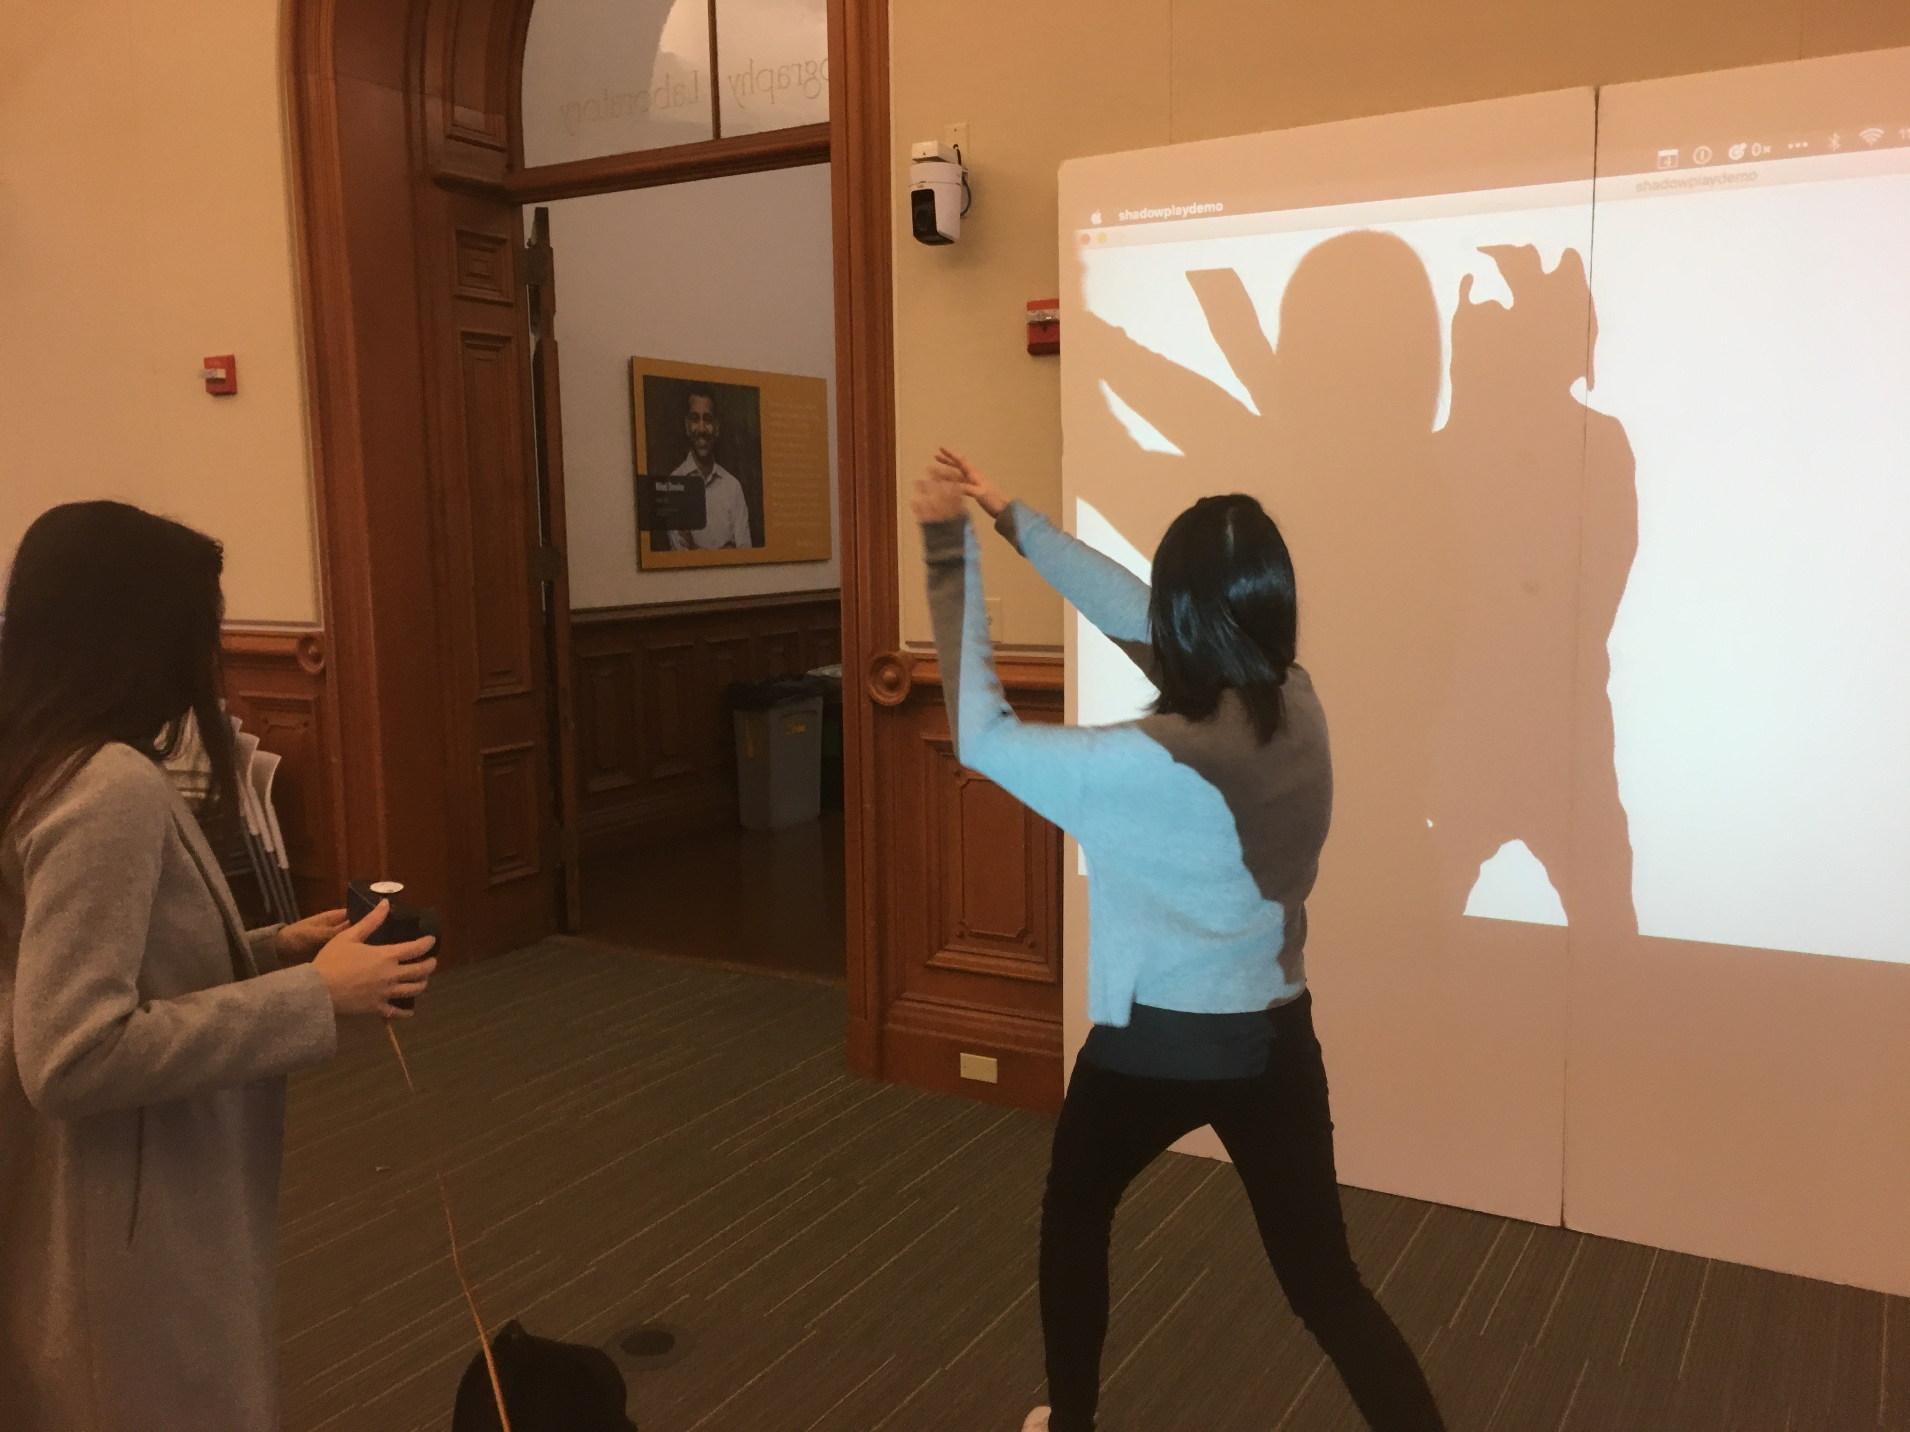
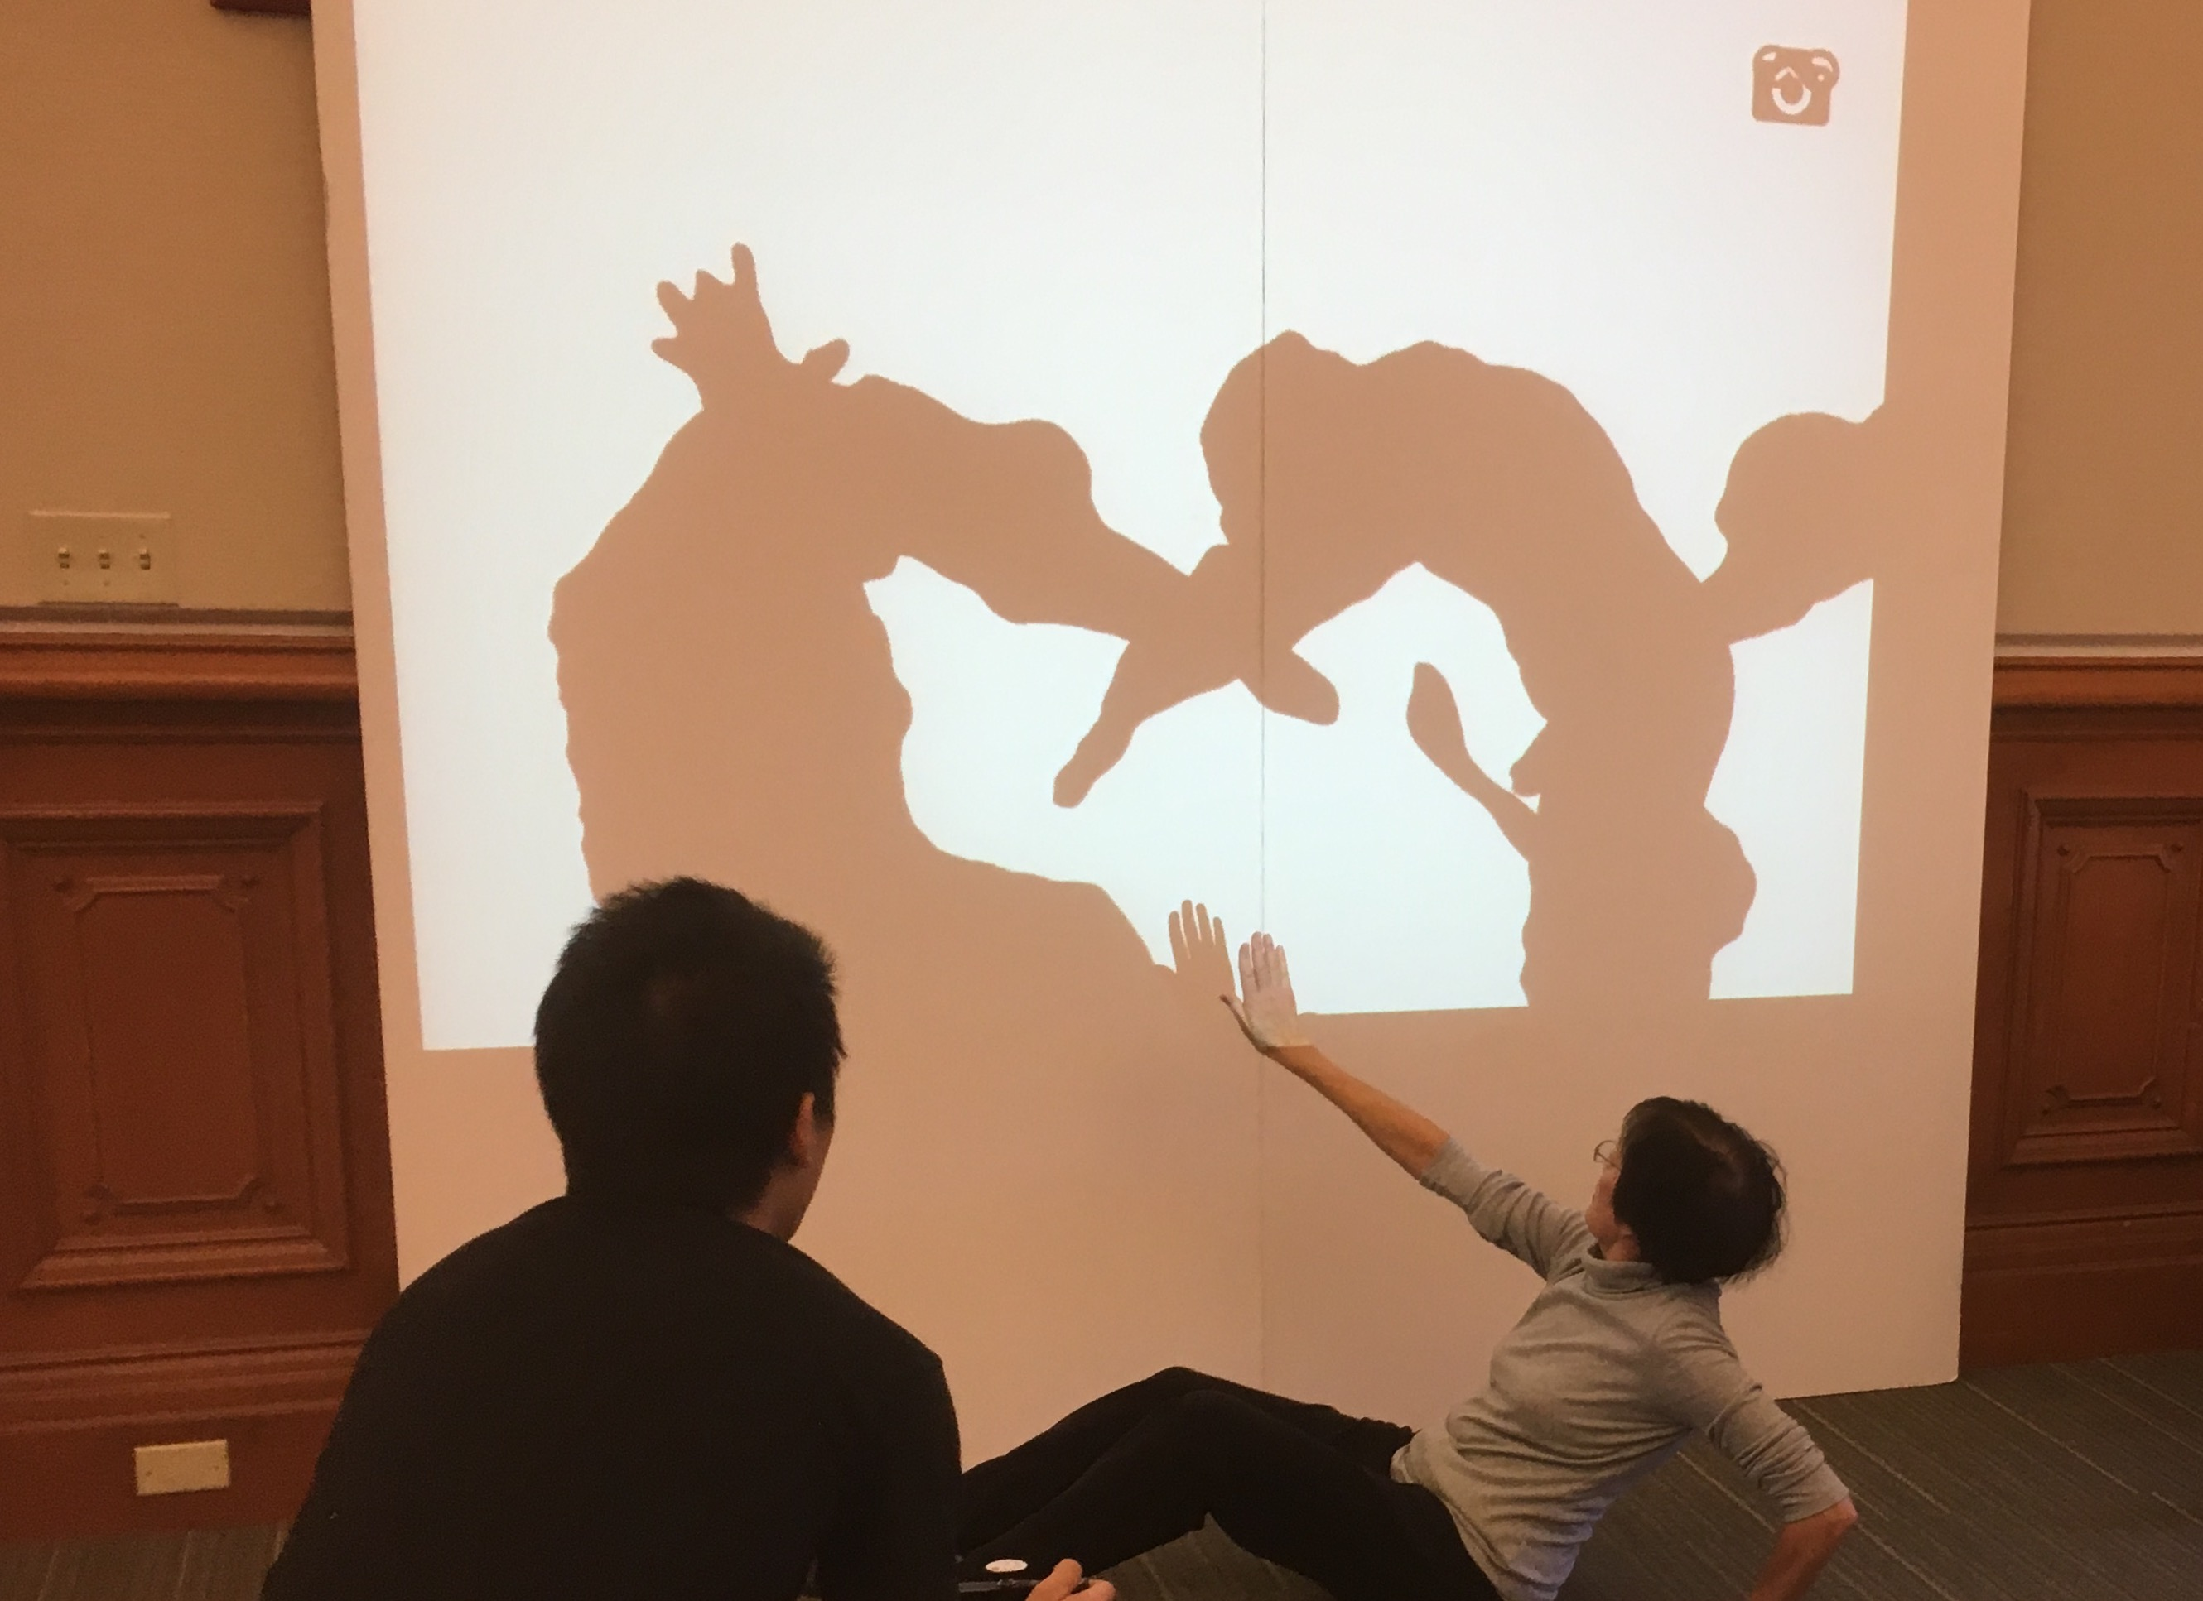
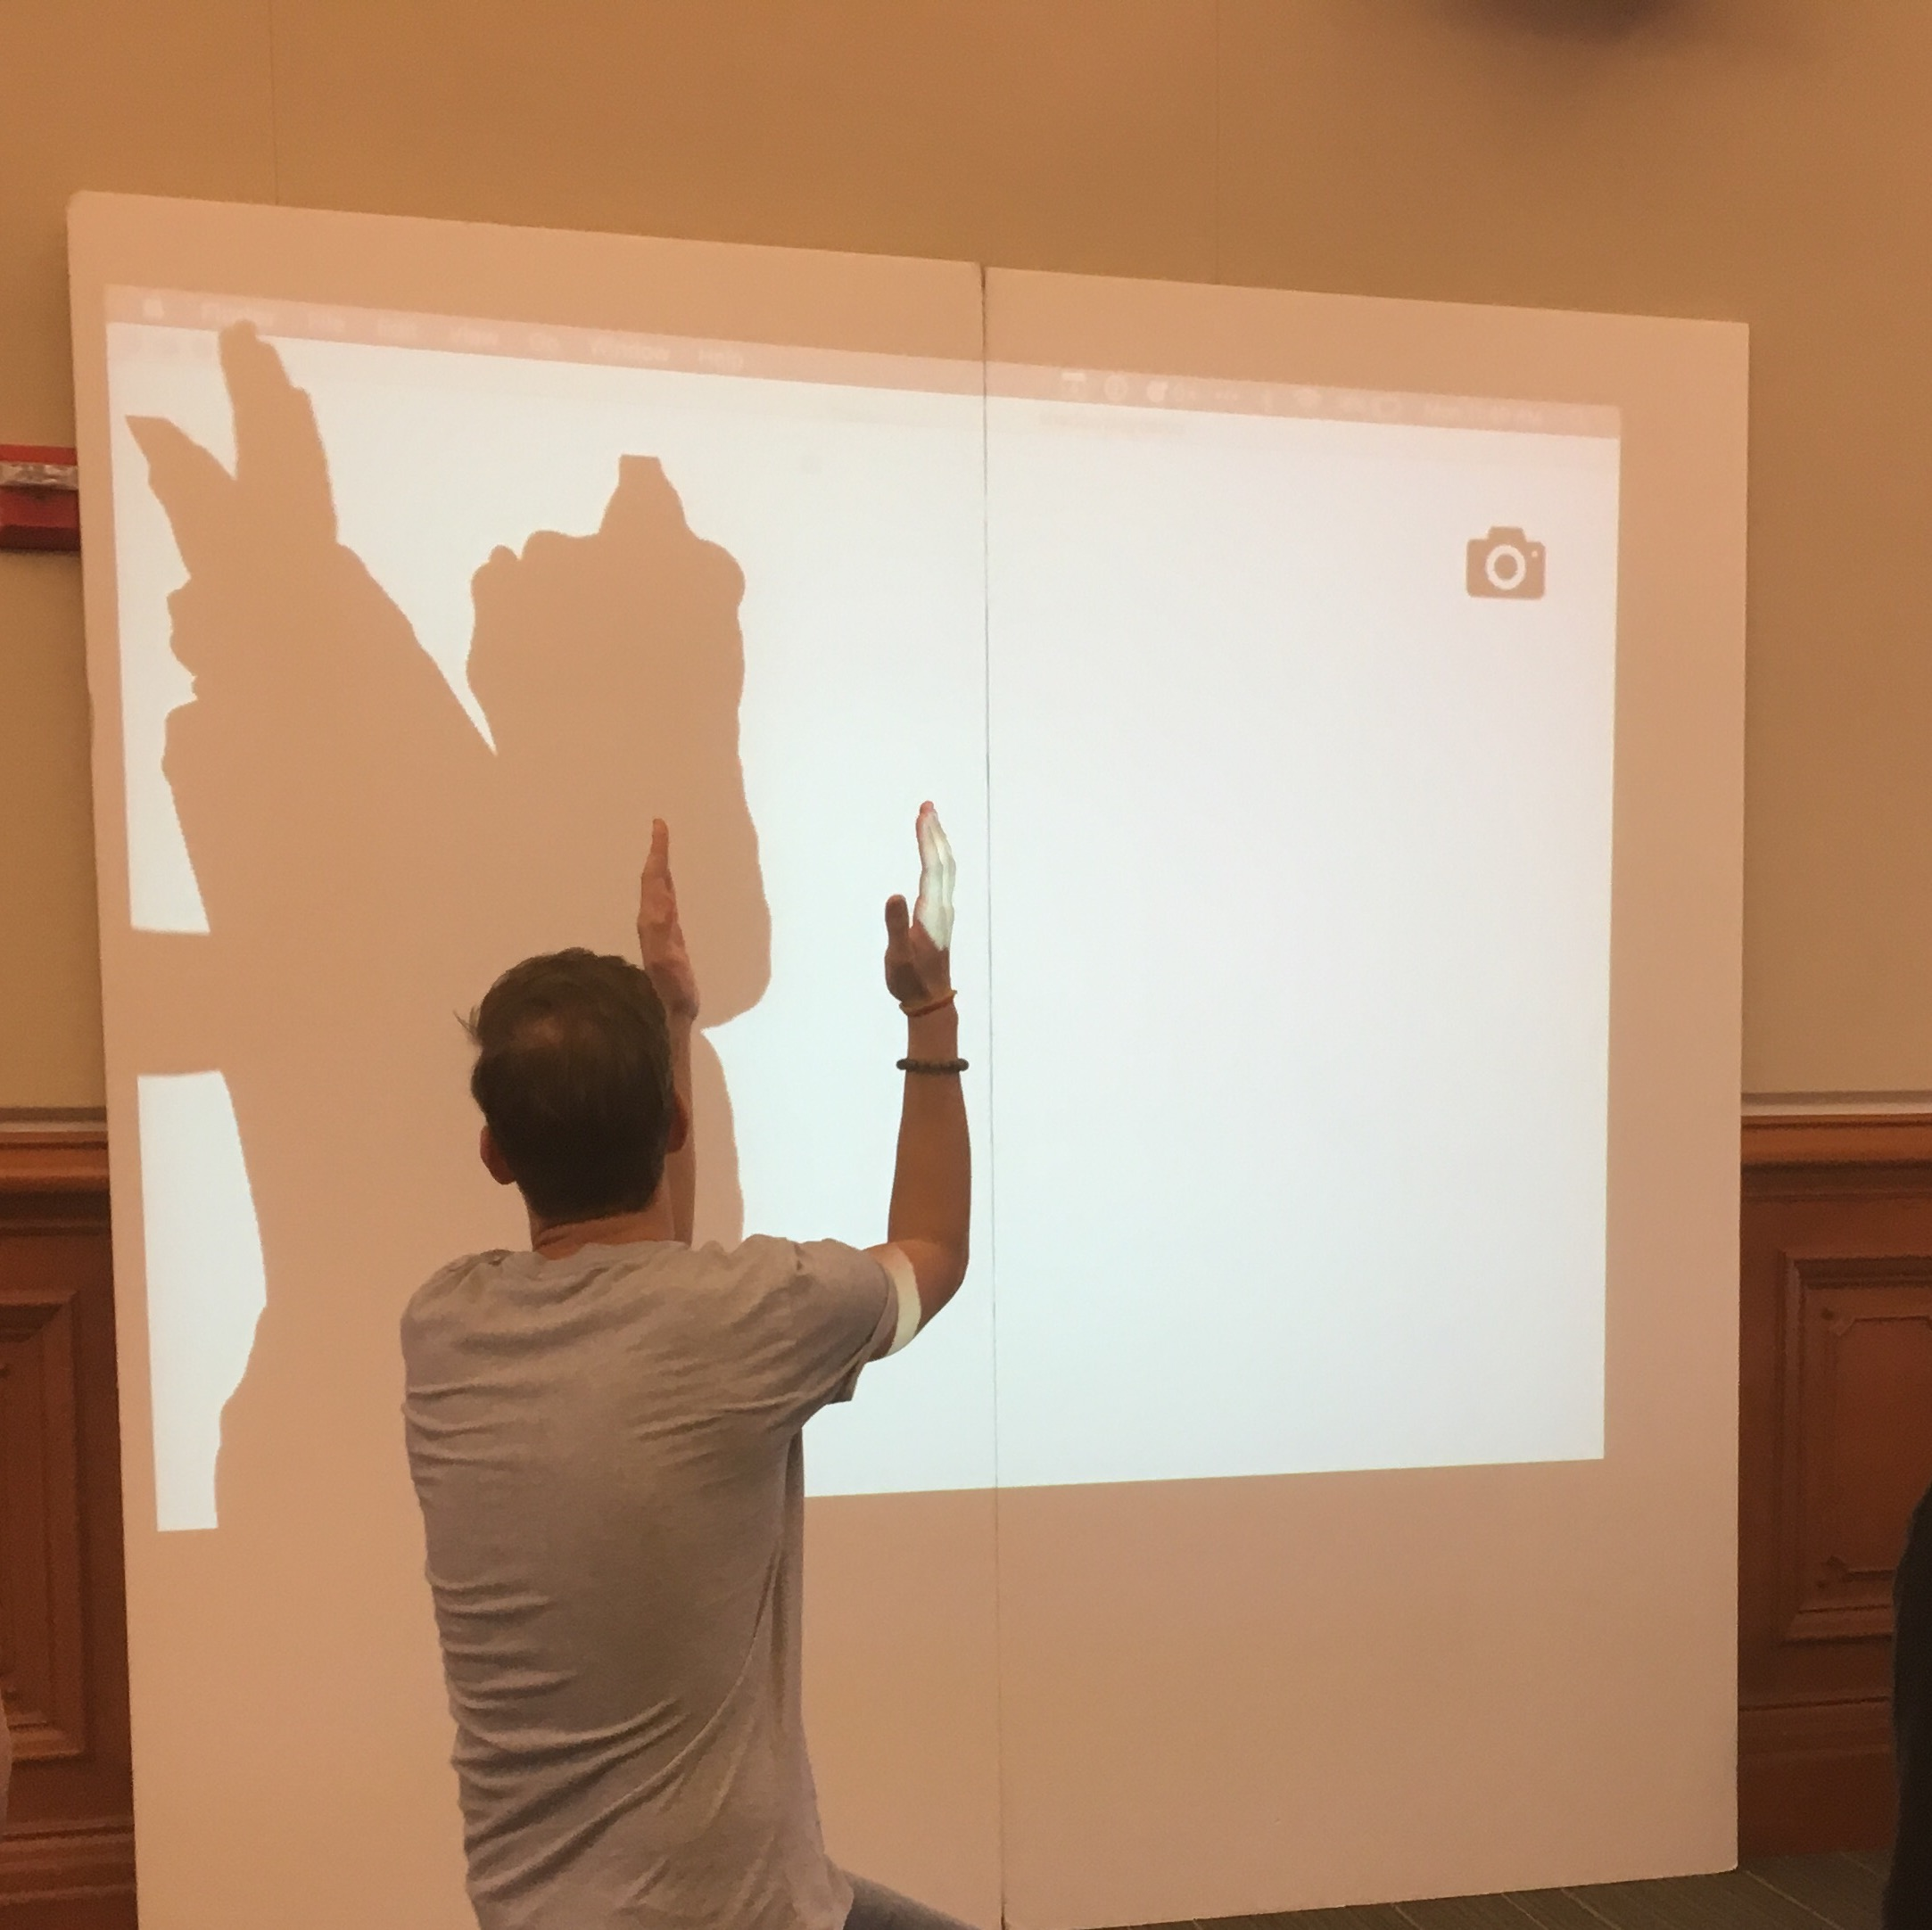
1. Set Environment
Use Snapshot to create static background images

Slide 5
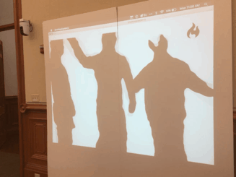
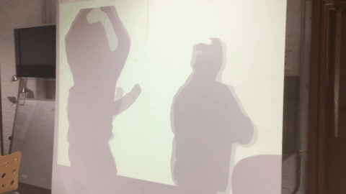
2. Add Motion and Effects
Use loop and fire to add motion and flair to your shadow

Slide 6
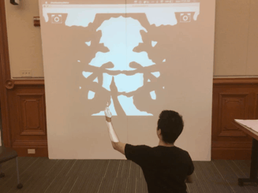
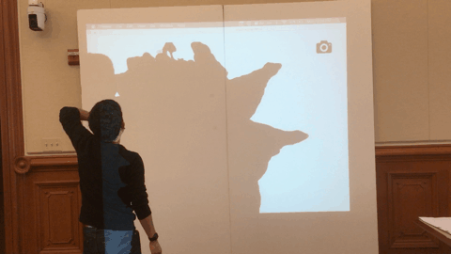
3. Advanced: Mirror and Patterns
Use mirror effect to create unique patterns and images

Slide 7
Try these examples!
Reaching out to your shadow’s finger tip
Heart shape with your mirror shadow or friend’s
Farting out fire ball
Shooting fireball to your mirror self
Multiple hands waving out from you
Mountain scenes and trees
Animal figures (bird, dragon, fish)
Monster face shooting fire
Unique Mirror patterns
Unique pattern of your own
Creative dance moves combined

Slide 8


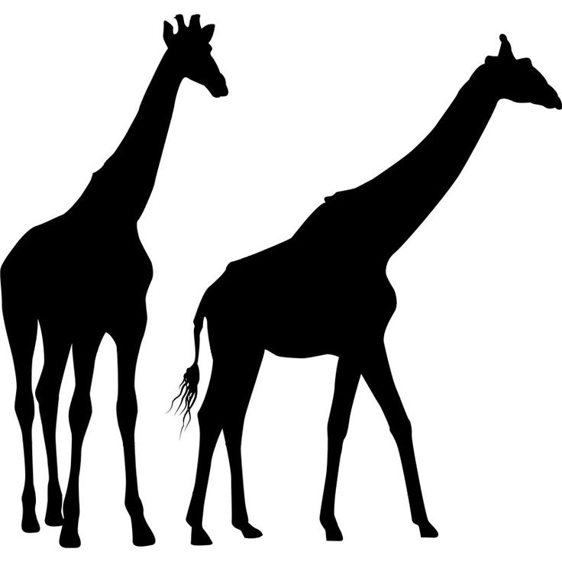






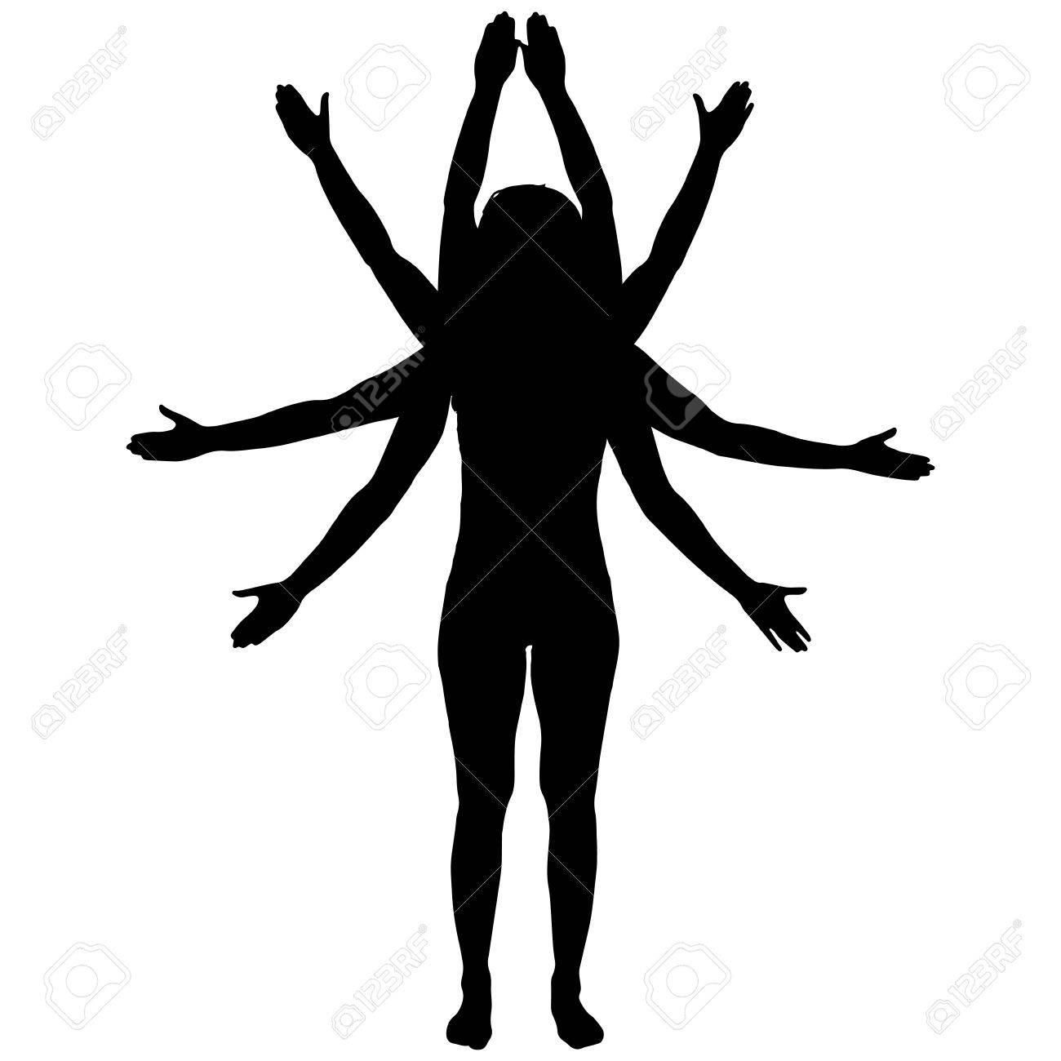

Try these examples!

